Slide 1
How the ESFA can support school business professionals through the School Resource Management offer
Lindsey Roberts– SRM Engagement and Outreach
May 2024

Slide 2
What is the School Resource Management (SRM) offer?
The department’s SRM offer is a collection of free tools, guidance and support, designed in partnership with the sector, to help schools and trusts get the most out of their resources to maximise learners’ outcomes. The offer is available to all state-funded settings in England.
SBPs to have skills, knowledge and capacity to achieve excellent SRM.
Supporting the delivery of financially affordable curriculum and the deployment of staff.
Help schools and trusts get the best impact from non-staff spend.
Aims of the programme
Support and services on offer
Free SRM training webinars
One-to-one mentoring
Qualification bursaries
Local support offer
Good Estate Management for Schools (GEMS)
Digital standards
Integrated Curriculum Financial Planning (ICFP) tools and guidance
Agency Supply Framework
School Workforce Planning guidance
Get Help Buying for Schools
Risk Protection Arrangement
DfE approved frameworks
Teaching Vacancies service
Using your data and free, expert support to enable you to achieve excellent SRM
School Resource Management Adviser (SRMA) programme
Financial Benchmarking Service and View My Financial Insights (VMFI)
Chart of Accounts

Slide 3
What support is available to me as a school business professional?
We are committed to ensuring school and trust business professionals have the skills, knowledge and capacity needed to achieve excellent school resource management and offer a variety of training and support. Including:
Qualification bursaries
We are supporting new and aspiring CFOs through targeted bursaries where there is evidence of need (e.g. being new to role, financial issues, skill gaps) and promoting / signposting to opportunities for where the bursary option will not be available.
Level 7 Diploma in School Financial and Operational Leadership – CIPFA
One-to-one mentoring
Last year, the ESFA ran a pilot mentoring programme, pairing school business leaders with new or less experienced academy trust CFOs.
The impact data from the pilot was overwhelmingly positive; 93% of mentees highlighted an increase in knowledge and confidence and 74% implemented changes following the mentoring.
The one-to-one mentoring offer is now part of the wider School Resource Management Adviser (SRMA) programme.
New local support offer
In 2024-25 we will be funding in-person training delivery, in response to feedback from the SRM Webinar series that people need more support on topics like ICFP.
We expect 80 events by August 2025 and 1,600 professionals trained.

Slide 4
SRM Training Webinars
We run free, live and interactive SRM training webinars. These are open to school business professionals, headteachers, senior leadership teams, curriculum leads, governors and trustees, estates staff, HR and IT staff at both maintained schools, academy trusts and local authorities.
The next round of webinars is due to begin in autumn. They will cover a range of areas within SRM, all designed to help you plan and use your resources even more effectively, including:
Sustainable estate and climate action plans
Becoming an academy
Academies Annual Return (split introduction/practical guidance)
Use of school/trust assets and facilities
Digital standards and AI
Procurement
HR
ICFP practical examples (possible split primary/secondary)
Strategic estate management and strategic financial planning
You can access the latest round of webinar recordings at: https://www.schoolresourcemanagement.co.uk/
99%
94%
of respondents would recommend the session to others.
of respondents said their knowledge had increased because of the training

Slide 5
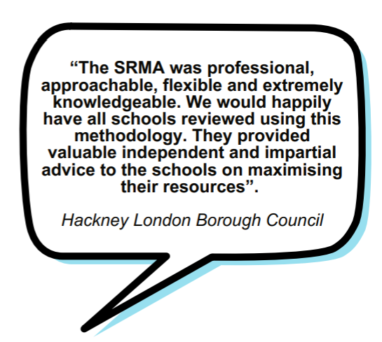
The School Resource Management Advisers (SRMA) programme
The SRMA programme provides free, independent and bespoke advice and peer-to-peer support from experts in this field.
The SRMA’s skills and experience will be matched to your specific context and SRMAs work across all types of educational settings.
The SRMA programme can be tailored your needs; you can choose from either a comprehensive review or more focused support.
Feedback on the programme has been positive with 92% of respondents reporting their experience of an SRMA visit as good or very good and 89% advising that they found the recommendations useful. *
The School Resource Management Adviser (SRMA) programme
*Figures from our 2022-23 survey

Slide 6
Guidance and Advice
Digital
Estate Management
We have published a number of digital standards which provide guidelines to support your school or trust to use the right digital infrastructure and technology Meeting digital and technology standards in schools and colleges service on gov.uk.
We have issued guidance, including good estate management for schools (GEMs) and managing asbestos in schools (MAGS). Our Estate management competency framework sets out the skills and knowledge needed to manage school estates effectively.
Capital Advisers Programme – supporting trusts with their estate management by providing bespoke recommendations from experienced technical experts, and building our understanding of capability
The most recent standards are on cyber security – this will help tackle live harms in schools and colleges.

Slide 7
Getting best value from non-staff spend and support with procurement
The SRM offer is designed to help schools and trusts get the most out of their resources, this includes getting the best impact from non-staff spend. We have a variety of services and tools to support this, including:
Risk Protection Arrangement
An alternative to commercial insurance, provided by the DfE, which offers schools and trusts:
financial protection: the RPA will cover the cost of any losses that your school suffers, within the scope and up to the limits of your membership
peace of mind: knowing that your school is financially protected within the scope and up to the limits of your membership, so you can focus on teaching and learning
access to support: the RPA offers a range of support services to its members, including risk management advice and training
The service now also includes Cyber cover.
DfE Frameworks
We offer a number of DfE approved frameworks which can help schools and trusts save time and money on regular purchases.
Frameworks include; energy, furniture, cleaning services, and ICT.
These frameworks also support schools to buy compliantly through quality checked suppliers.
Support schools and trusts to buy goods and services compliantly, and have peace of mind that they are getting good value in terms of cost, quality and time.
Our experienced procurement team work exclusively with the school sector and offer different levels of service and support depending on your school or trust’s needs and level of confidence.

Slide 8
Using your financial data
Schools financial benchmarking service - a public-facing tool that everyone can access which enables you to benchmark your income and expenditure against other schools or trusts to support school resource management.
View my financial insights tool - provides insights to time-pressured users in schools, offering a priority list of areas to investigate. It also gives local authorities an overarching view of all their maintained schools.
Updates to the service:
We are bringing together the SFB and VMFI services into one place. This means that 95% of the functionality on the site will be in the public domain, thereby removing the pain point for many users that accompanied the need for a password. We will also incorporate all of the extra features that we've been able to build on VMFI such as Curriculum & Financial Planning and improved metrics and comparator group algorithms.
We also plan to develop and release new functionality improvements to follow soon after including more data on inclusion, workforce deployment and a platform to encourage inter-school and inter-trust collaboration.

Slide 9
Teaching Vacancies Service – helping schools put funding back into the classroom
The problem the service is trying to solve is the cost to schools of teacher recruitment – estimated at £75 million a year.
Currently schools can list teaching, leadership and education support vacancies.
Free, trusted and a great reach of jobseekers.
86% of schools are signed up to use Teaching Vacancies and the service is one of the largest source of vacancies listed directly by schools in England.
An average of nearly 300,000 unique jobseekers visiting Teaching Vacancies every month and over 67,000 jobseekers signed up for job alerts.

Slide 10
School Resource Management - What are our users are saying about the offer?
SRMAs and One-to-One Mentoring
SRM Training Webinars
Savings
SRMAs have supported over 1,500 trusts and local authority-maintained schools since the programme began in 2018.
92% of schools and trusts providing feedback about an SRMA visit have rated their experience of working with an SRMA as good or very good.
90% agreed the SRMA report delivered useful recommendations.
93% of one-one mentees highlighted an increase in knowledge and confidence in their respective areas of development including ICFP.
74% of mentees implemented changes in school or trust processes after mentoring.
91% felt the training better equipped them in their role and the same proportion that the training would have a positive impact on their school(s) or trust
99% of respondents would recommend the session to others.
67% of respondents believe the training will help them consider opportunities for financial savings
94% of respondents stated that their knowledge had increased because of the training
1500
91%
RPA has saved an estimated £118.1m for academy trust members in FY 2022/23
RPA has saved an estimated £17.3m for local authority-maintained school members in FY 2022/23
Get Help Buying for Schools has saved schools and trusts an estimated £6.7m in FY 22/23.
Based on feedback from schools, we estimate that Teaching Vacancies has saved state funded schools in England between £26.4m and £34.5m (September 20 - August 23).
£118m
92%
£17m
99%
90%
67%
£6.7m
93%
94%
£26.4m
93%
"Not a saving but I wanted to acknowledge how the training has altered my mindset so that my approach to work is more strategic. This is now driving processes and systems more efficiently and effectively."
74%

Slide 11
How to access the SRM offer
You can access the full collection of SRM tools, guidance and support at the on our gov.uk page
Or to learn more about the SRM offer, check out our SRM YouTube playlist

Slide 12
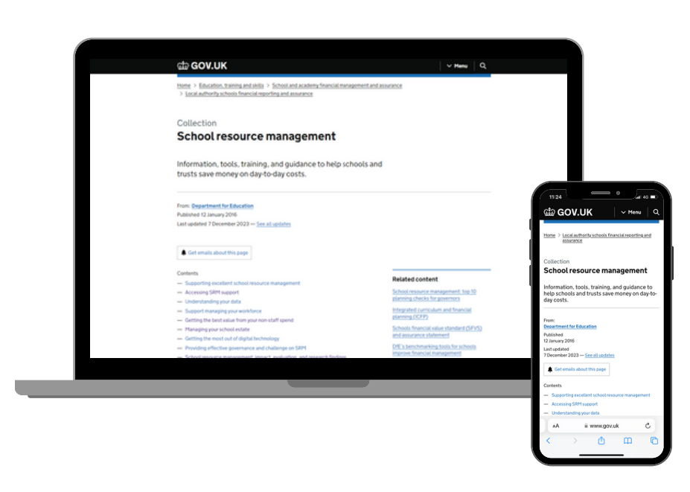
Useful Links
You can access all of the SRM tools and support mentioned today via the School Resource Management (SRM) Collection page as shown on the previous slide, or you can access each of the tools directly using the links below.
Accessing SRM support
Understanding your data
Managing your school estate
Supporting excellent school resource management
SRM training webinars
Support managing your workforce
Getting the best value from your non-staff spend
Getting the most out of digital technology
Providing effective governance and challenge on SRM
School Resource Management (SRM) Youtube playlist
‘So, one of the great things about the programme is, it costs the school nothing, and we get some really valuable advice for that, that you know if we were trying to source that on our own, would cost us quite a bit of money.’
- Andrew Taylor, Headteacher at St. Gabriel's in Rugby

Slide 13
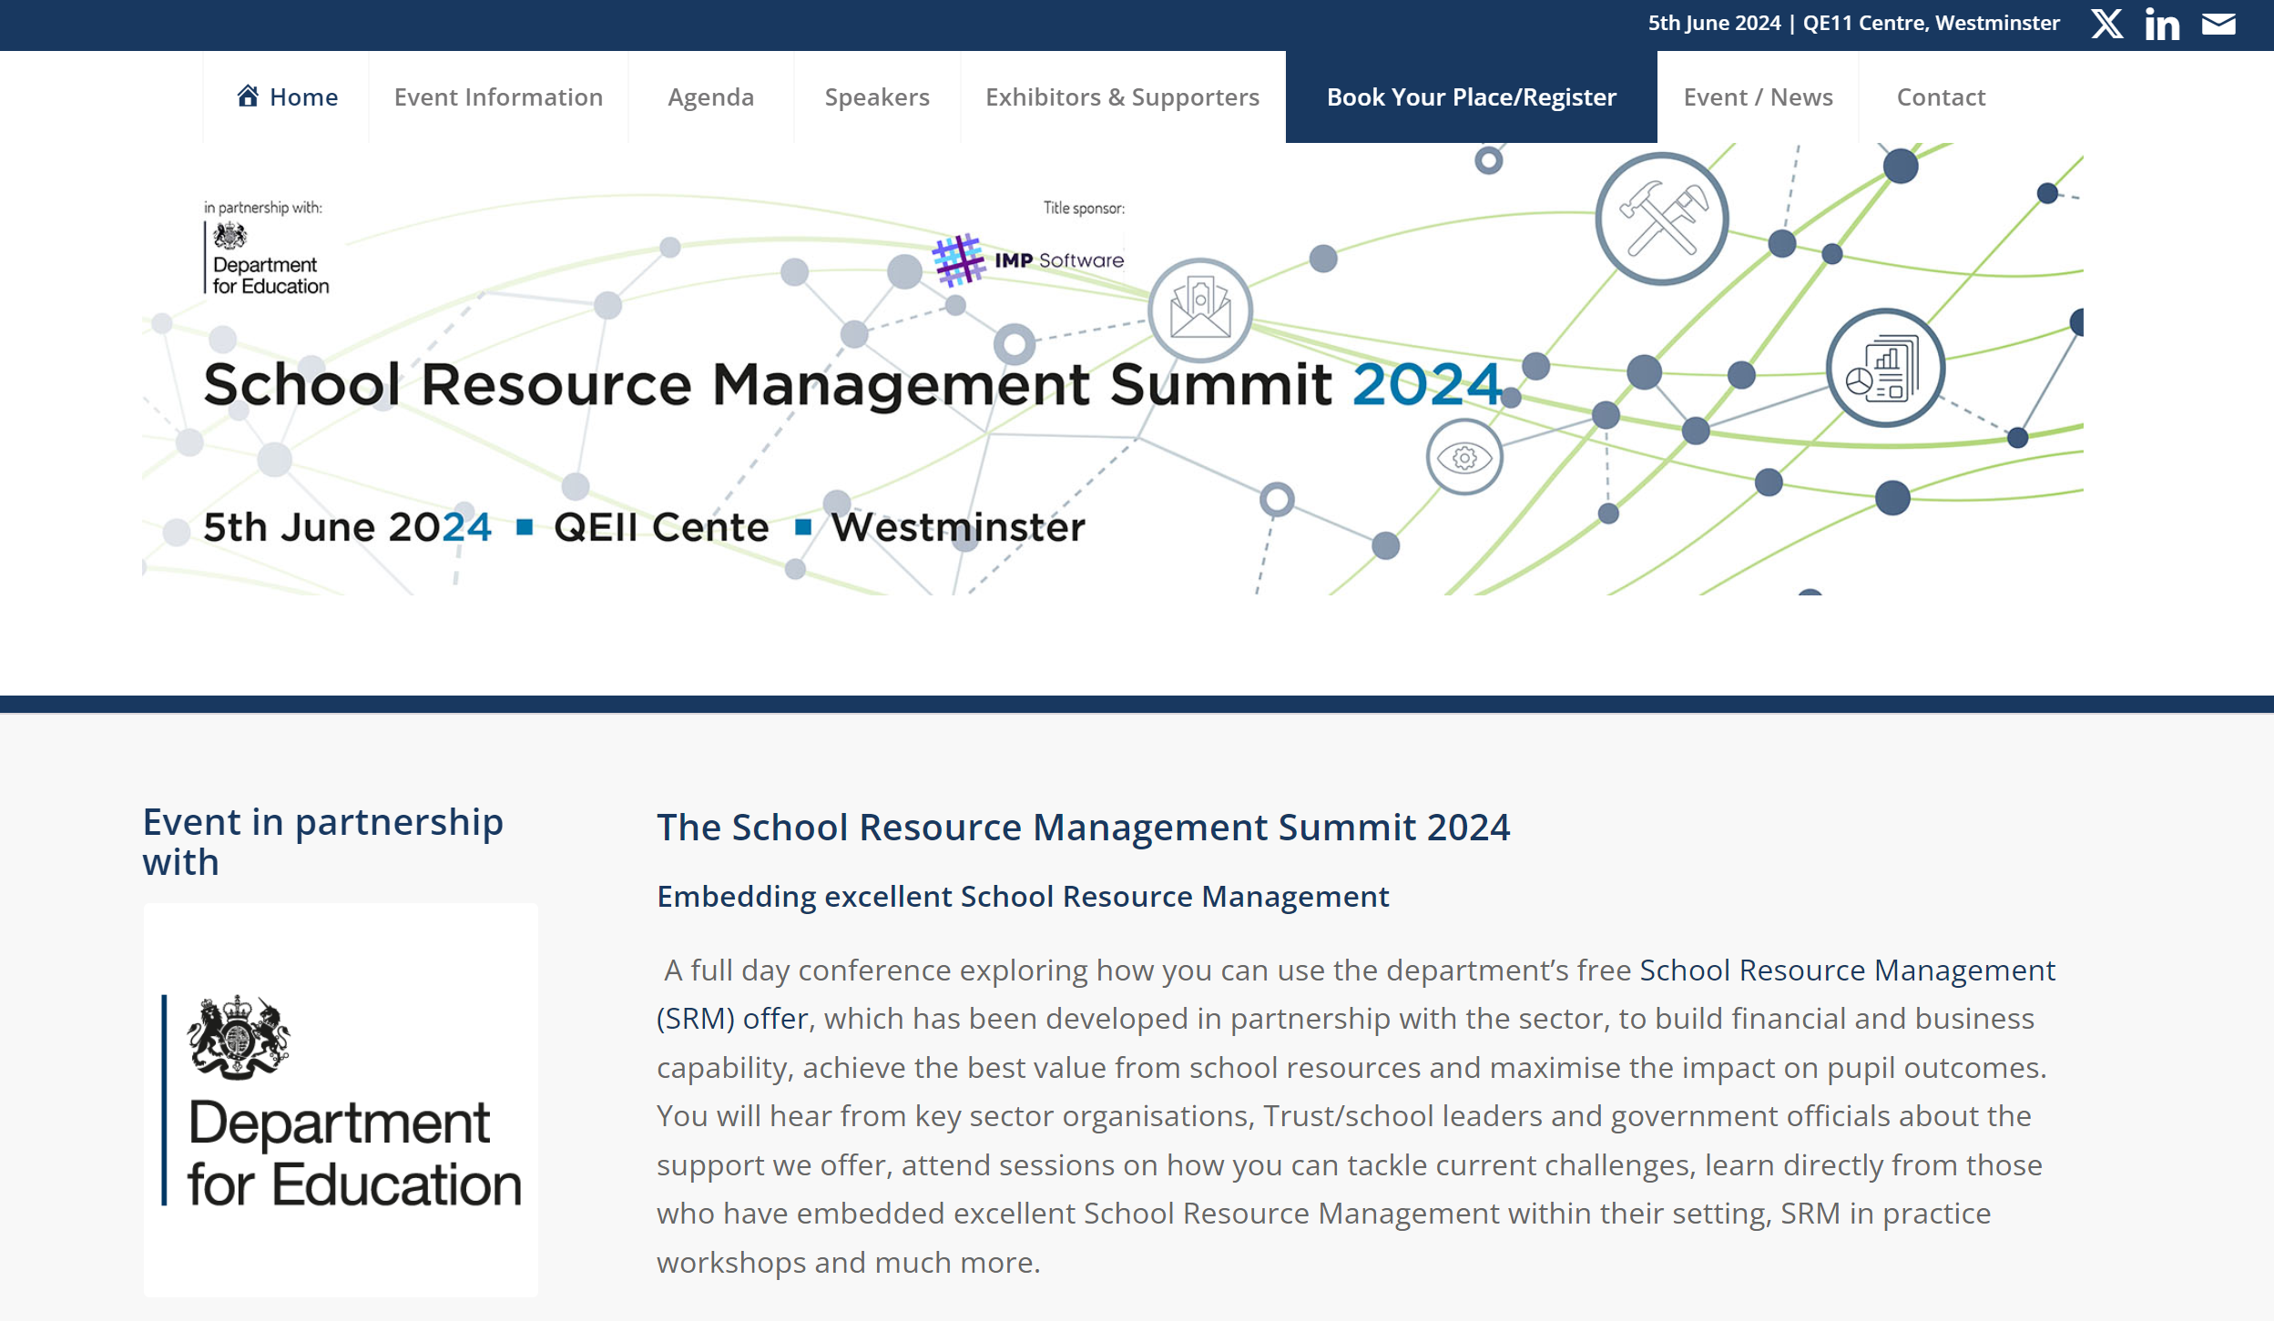
SRM Summit 2024
School Resource Management (SRM) Summit 2024, is being held at the QEII Centre, Westminster on the 5th June.
You can sign up now at: https://schoolsrm.com/

