Slide 1
Establish an Energy Strategy for your school
Specialists in procurement and Net Zero solutions

Slide 2
Business Cost Reduction Associates Limited
Formed 2005
Procurement and Net Zero Consultancy business
23 staff
1200+ Clients across the U.K
Manage over £1 billion of energy spend
Core Sectors – Manufacturing, Education, Health and Care, Professional Services and Hospitality and Leisure
Associate members of the BH&HPA and ISBA
Members of the ADR scheme – full disclosure on all clients since 2021
Applying for B Corp
Authorised by the Financial Conducts Authority for Secondary credit broking services. (FRN 712778)
Own energy platform – Visible Energy
Own carbon platform – Visible Carbon

Slide 3
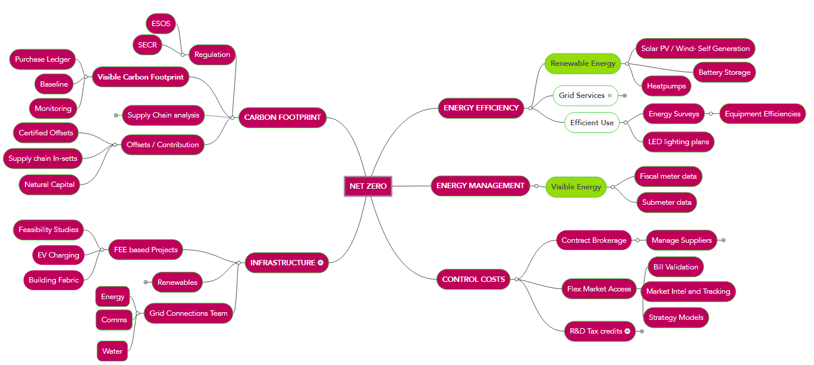

Slide 4
How are Energy contracts constructed?
Unit Price
Wholesale | Non Commodity
Traded commodity 6p – 95p | 27 Government taxes 7p – 15p
7p | 14p
Other costs Standing Charges Day Rate/Night Rate KVA CCL
Other features Volume Tolerance
Product Types Fully Fixed Fixed and Inclusive Fixed Pass Through Flex

Slide 5
Which is the best value for your school
Supplier | Cost | Notes
British Gas | £105,000 | F&I
EDF | £103,000 | FF
N Power | £99,000 | F&I with VT
SSE Protect | £104,000 | FF
SSE Choice | £102,000 | F&I

Slide 6
Establishing a baseline
How does your site use energy?
Monthly billing
Data
What are your large energy consumers?
What is still consuming energy at 2am – Establishing a baseline
Security cameras
Lighting
Fridges
Swimming Pool

Slide 7
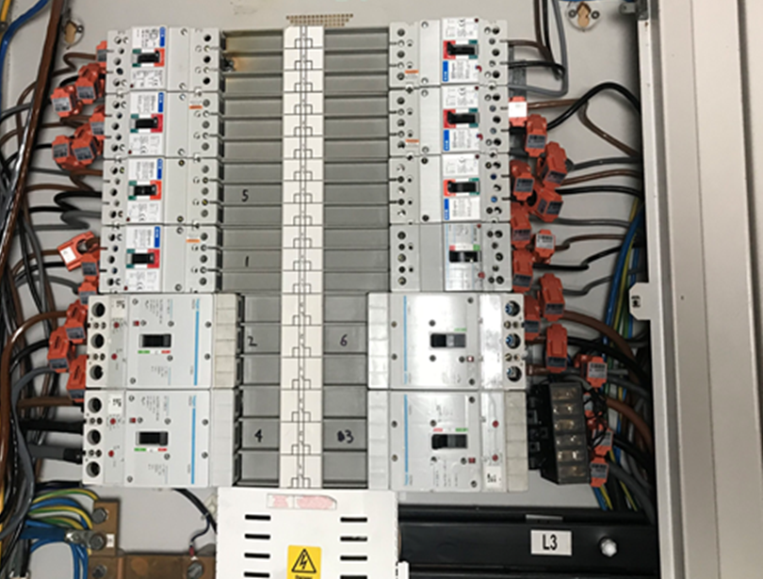
Energy Management
KVA
Baseline
Business Management System
Data Management
Working patterns
Future proofing
Compliance SECR

Slide 8
Future proofing your school?
Site Audit
Contract review
Site Infrastructure review
Plans for the site
Onsite generation opportunities
Recommendation
Infrastructure
Sub metering
EV Car charging points
Hydrogen
Onsite generation

Slide 9
Energy Efficiencies
Establish an energy strategy for your school
What Renewables should we consider?
Solar PV (include lightweight solar)
LED Lighting
Wind Turbine
Bio Mass
Anaerobic Digestion
Battery Storage
Heat Pump
What else do we needs to considered ?
KVA
Site suitability
DNO

Slide 10
The benefits of onsite generation – Solar PV?
Generate you own green electricity and save money on your energy bills
Protect yourself from rising energy costs
Cut Your Carbon Footprint
Inflation Linked Tax Free Income for 20 Years
Long System Life and Minimum Maintenance.
Demonstrate your commitment to the environment
Increase your property value
Funding options - Cap Ex - Lease purchase - Power Purchase Agreement

Slide 11
Summary
Review your current energy contracts – The contracts, term, type and features, highlight any risks to the contracted budget.
Understand how your site uses energy - What is your baseline?
Review current power supply to site, understand the largest users – Example Swimming pools 20-65% cost of total energy for most sites.
Plans for the site – Futureproof site, upgrade, review KVA and look at future power demands which include EV charging.
Where possible consider onsite generation.
Establish an Energy strategy for your school

Slide 12
Establish an Energy Strategy for your school
Specialists in procurement and Net Zero solutions
Get in touch
Steve Bolt
E: steve.bolt@bcrassociates.co.uk
T: 03300 245 405
M: 07921 780549

