Slide 1
Managing Building Costs & Driving Sustainability
Jack Jones – Product Manager

Slide 2
The Department for Education’s annual report published in December 2022, identified the condition of school buildings as one of six ‘significant risks’ the Department was managing. The report noted that the situation had worsened during the year, and was unlikely to improve during 2022. As of the 2023 annual report, School Buildings remains a top 3 risk with a rating of ‘Critical’ impact and ‘Very Likely’ likelihood of occurrence.

Slide 3
What’s the average £ condition need per school, in order to bring a school up to an acceptable standard? As per the DfE Annual Report 2021

Slide 4
£516,390
Notes:
Across England, based on DfE data from 2021, the average school would need around £516,000 worth of condition spend in order to bring it up to standard.
Based on everything that has gone on in the economy between 2021 and now, as well as the fact that buildings have aged another 3 years, it’s fair to say that figure will have increased further.

Slide 5
What’s the average £ condition need per school, per m2 of area within said school?

Slide 6
£150
Or
£8000 per classroom
Notes:
OK, putting it into more context
£150
On average each school across the country needs to spend £150 of funds per square metre of space, in order to make it safe and up to standard based on the DfE’s report.
For context, DfE guidelines suggest that a typical Key Stage 2 classroom housing 30 children should be around 55m2.
Therefore, as a rough measure, the average expected spend needed is around £8000 per classroom.

Slide 7
£310k on average needed per Primary school
£1.6m on average needed per Secondary school
£11.5b total condition spend needed
4,363 Academies eligible for Condition Improvement Fund (CIF)
£450m budget for 2024-2025
22,020 Schools eligible for School Capital Funding (SCA and DFC)
£1.8b budget for 2024-2025
Notes:
Just some more highlight numbers again for the scale of the issue:
11,368,732,946 total spend is needed, which again is going to be a moving target of course.
Of the funds that schools and academies have access to, there’s roughly perported to be ~ 2.25b available, that’s across all schools throughout England.
Which is considerable shortfall in terms of the 11.5b number.
These numbers give a little bit of colour to the scale of the challenge at a high level, however I am keen to hear from you all, the experts in the field, living these challenges day in day out, on how big of an issue and priority this is to you and your schools/Trusts, how you’re approaching the challenge, and how software could help you.

Slide 8
What are your School or Trust’s top 3 priorities?

Slide 9
How do you balance spending across your School or Trust whilst ensuring safe buildings and environments? Does this differ for those of you eligible for SCA vs those that have to bid for the Condition Investment Fund?

Slide 10
Do you leverage software to help you to identify, prioritise and manage estates conditions & improvements?

Slide 11
What insights and information would you want to have at your fingertips to support you with accelerating your Trust’s journey towards safer buildings?

Slide 12
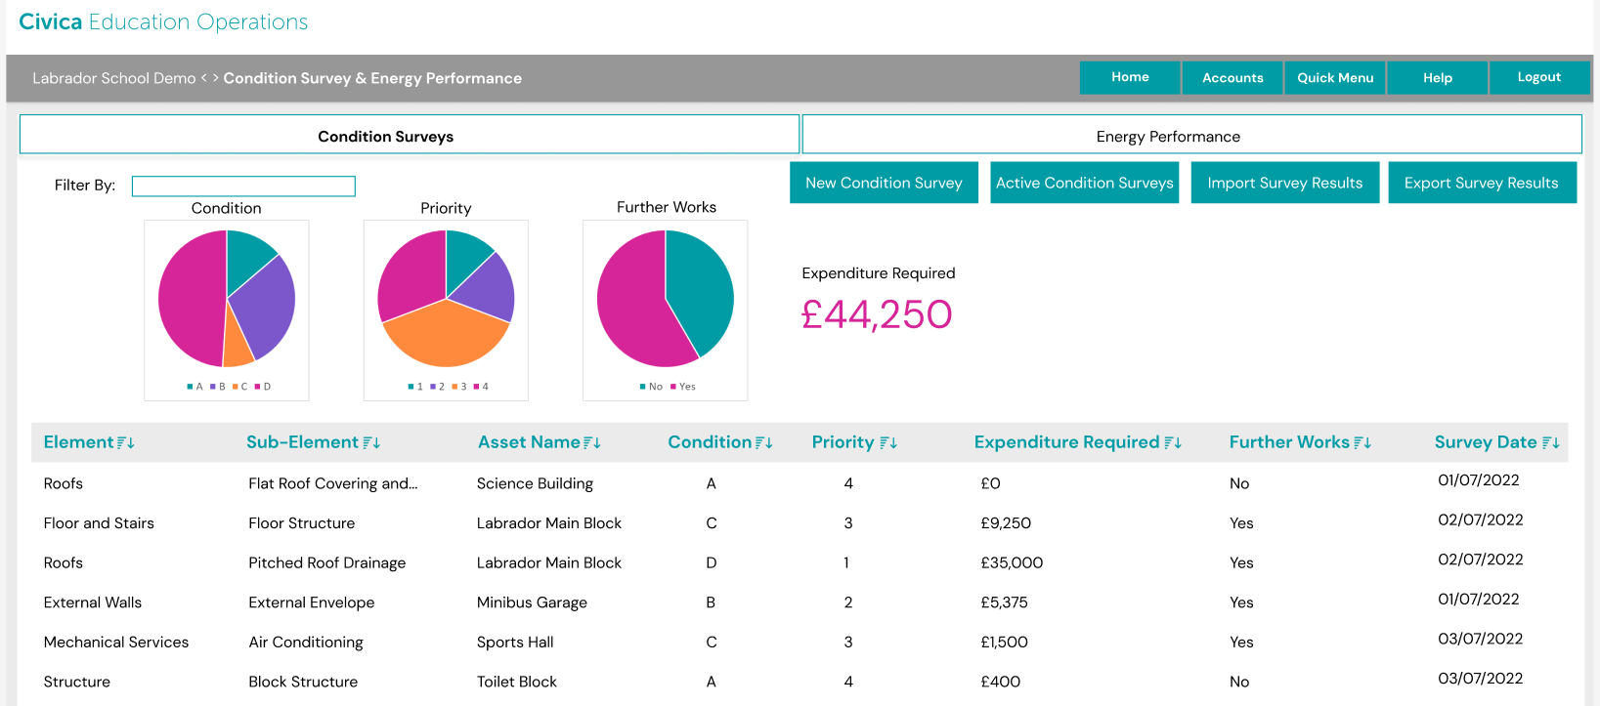
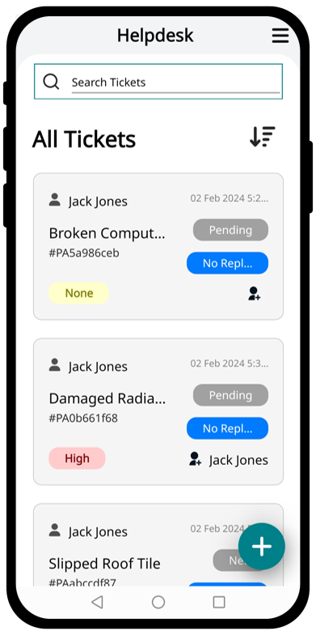
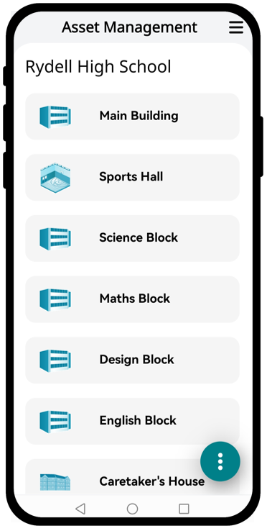
Civica Education Operations
Enabling statutory compliance, easy performance oversight whilst supporting effective growth with a single centralised source of truth across the entire Trust.

Slide 13
Get in Touch
Get in touch to find out more about how Civica can support your School or Trust in delivering safe and empowering learning environments for students and staff
Scan Here

