Slide 1
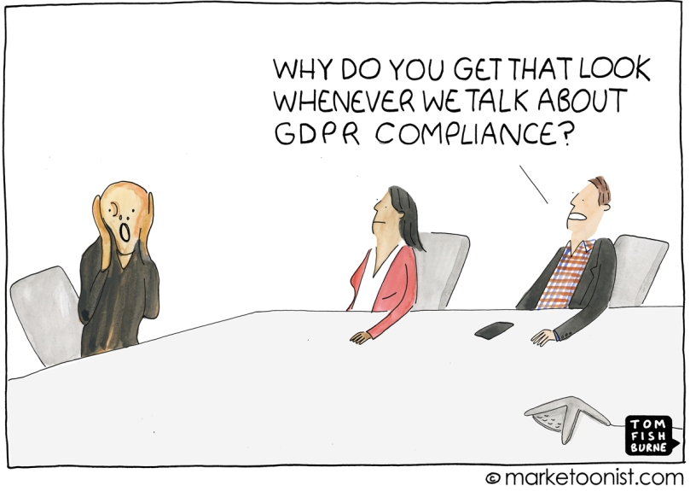
Six Years of the GDPR Six Things You Need to Know
What you actually need to know…

Slide 2
6 Things You Need to Know
Stick to your Principles
No means no… but consent isn’t the only option
Retention, Retention, Retention
The Importance of SARs
Processes for Processors
Breaches – Reduce Risk and React Swiftly

Slide 3
Stick to Your Principles
Principle 1
Principle 2
Lawfulness, fairness, and transparency
Principle 3
Principle 4
Principle 5
Principle 6
Principle 7
Purpose limitation
Data minimisation
Accuracy
Storage limitation
Integrity and confidentiality
Responsible for, and able to demonstrate, compliance with principles.
1
Notes:
(b) collected for specified, explicit and legitimate purposes and not further processed in a manner that is incompatible with those purposes; further processing for archiving purposes in the public interest, scientific or historical research purposes or statistical purposes shall not be considered to be incompatible with the initial purposes (‘purpose limitation’);
(c) adequate, relevant and limited to what is necessary in relation to the purposes for which they are processed (‘data minimisation’);
(e) kept in a form which permits identification of data subjects for no longer than is necessary for the purposes for which the personal data are processed; personal data may be stored for longer periods insofar as the personal data will be processed solely for archiving purposes in the public interest, scientific or historical research purposes or statistical purposes subject to implementation of the appropriate technical and organisational measures required by the GDPR in order to safeguard the rights and freedoms of individuals (‘storage limitation’);
(f) processed in a manner that ensures appropriate security of the personal data, including protection against unauthorised or unlawful processing and against accidental loss, destruction or damage, using appropriate technical or organisational measures (‘integrity and confidentiality’).”

Slide 4
No means no… but consent isn’t your only option
It is important to know what your lawful bases are for:
Processing Data
Sharing Data
2

Slide 5
No means no… but consent isn’t your only option
Article 6
Public Task – necessary for a task carried out in the public interest
Legal Obligation - necessary to comply with a legal obligation
Vital Interest - necessary to protect vital interests
Legitimate Interest – necessary for the purposes of legitimate interests for the controller or a third party
Performance of a Contract – necessary for the performance of a contract to which the data subject is a party
Consent
2

Slide 6
No means no… but consent isn’t your only option
Article 9 & 10
Special category data:
Personal data revealing:
Racial or ethnic origin
Political opinions
Religious or philosophical beliefs
Trade Union Membership
Special category data.
Genetic Data
Biometric Data
Health Data
Sex Life or Sexual Orientation
2

Slide 7
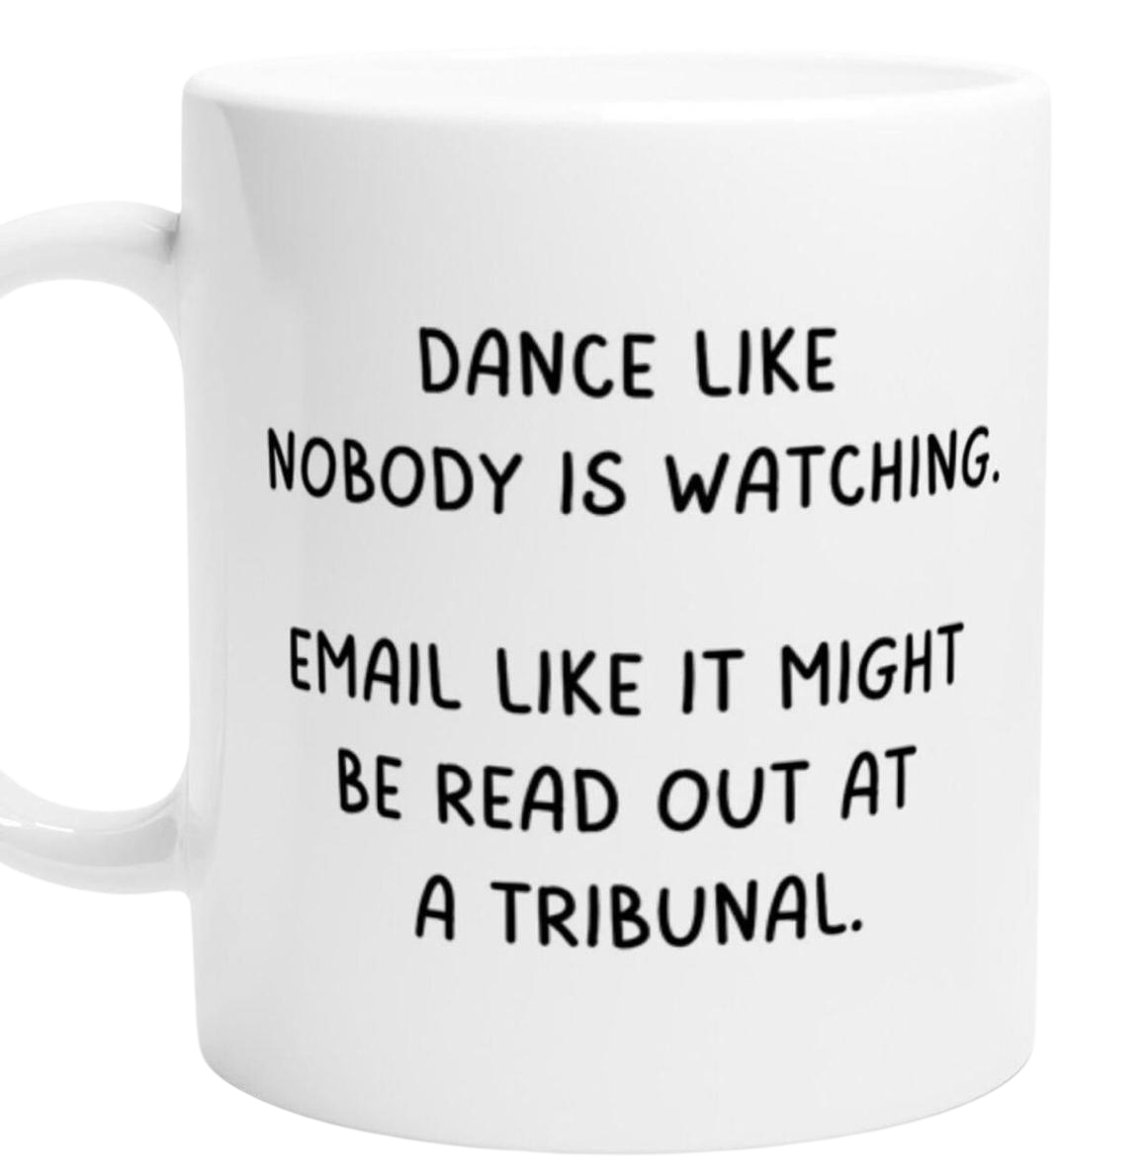
Retention, Retention, Retention
Implement Retention Schedule
Assign Responsibilities
Retention of Email
Tailor it to your organisation
Implement a retention schedule
Ensure key staff have responsibility
Professional use of email
Monitor compliance with the schedule
Consider email as an organisation
Operationalise the schedule
3

Slide 8
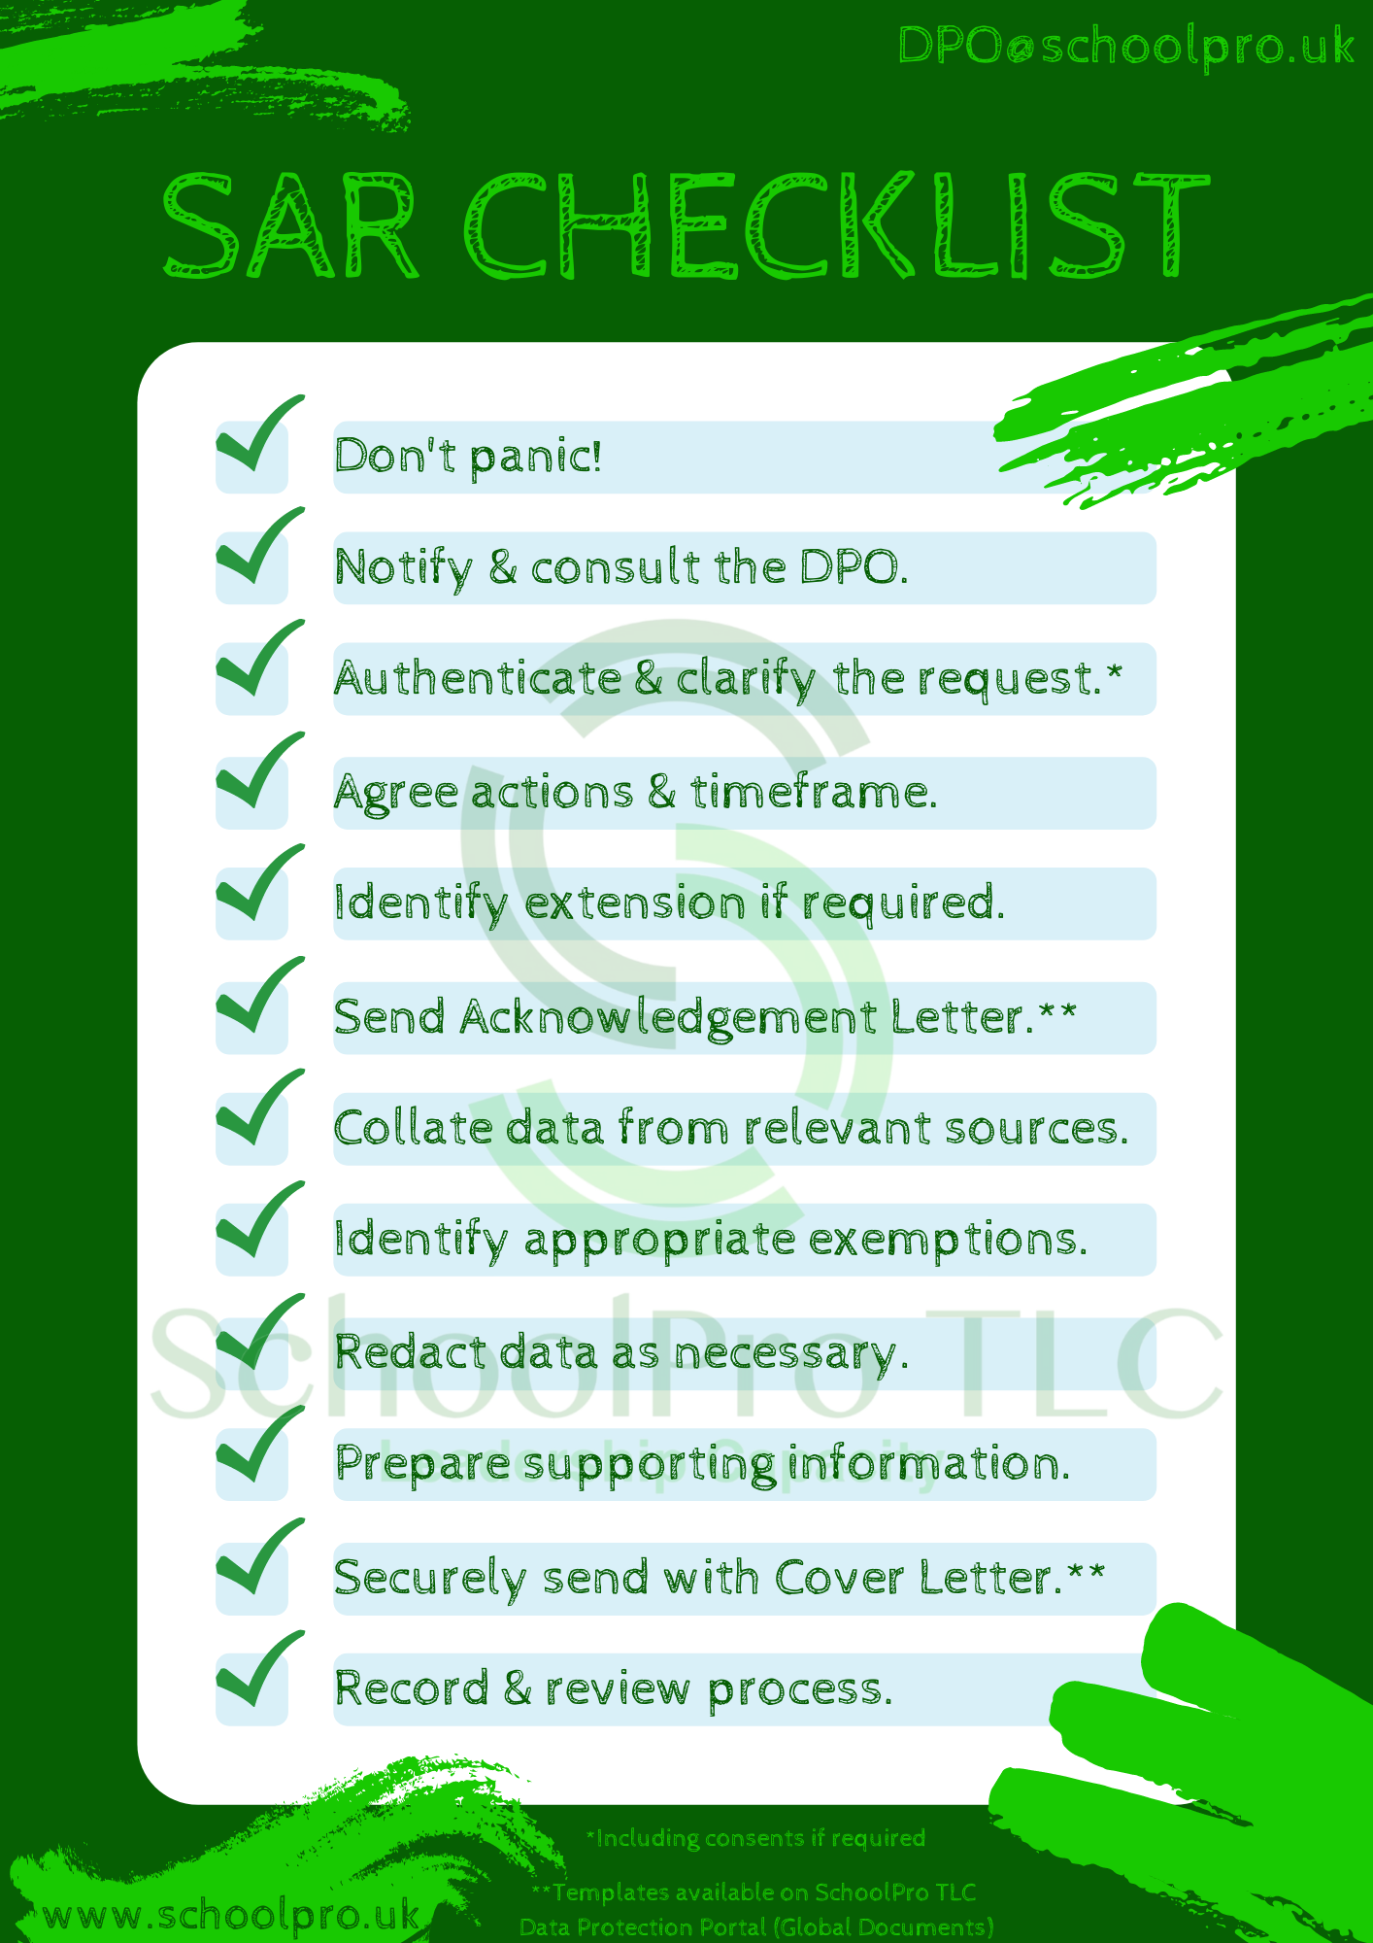
The Importance of SARs (Subject Access Requests)
What is a Subject Access Request?
Individuals have the right to access their personal data.
This is commonly referred to as subject access.
Individuals can make a subject access request verbally or in writing.
GDPR does not specify how the request is made.
Any employee could receive a valid request.
You have one month to respond to a request.
You cannot charge a fee to deal with a request in most circumstances.
4

Slide 9
Amending Data for a SAR
It is not acceptable to amend or delete the data if you would not otherwise have done so.
Under the Data Protection Act 2018 (DPA 2018), it is an offence to make any amendment with the intention of preventing its disclosure.
However, if you do not have personal data regarding a subject prior to a SAR being submitted, you can’t hand that personal data over!
The Importance of SARs (Subject Access Requests)

Slide 10
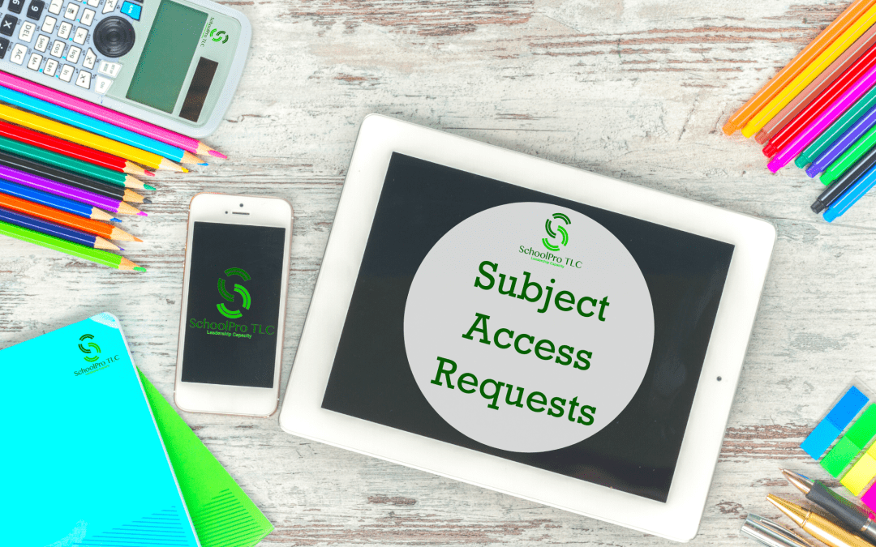
⚠️ The Importance of SARs
Remember that You have a Responsibility to Respond
Emphasise Training and Awareness for All Staff
Who do you report SARs to?
Do you understand the important of this and the timeframes involved?
Maintain Effective Data Management
Consider Email and Other Communication Channels
Promote Transparency
Understand the Possible Legal Consequences (ICO Reprimands)
4

Slide 11
Processes for Processors
5

Slide 12
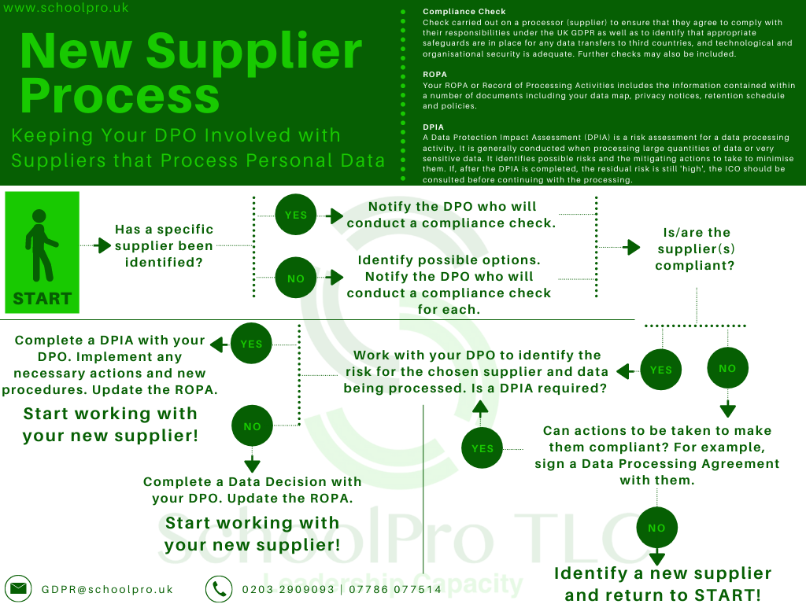
5

Slide 14
Breaches – Reduce Risk & React Swiftly
6

Slide 15
Email Breaches – How to Reduce Risk
Approximately 80% of the breaches on our system are related to email.
Check emails before they are sent so that you are less likely to make a simple error like using the wrong email address.
Password protect or encrypt files that contain personal information.
Avoid emailing files internally. Save files in a shared area on either your internal server or in the cloud (depending on your organisation) and update the shared document.
Avoid email for external communication where possible. Use alternative parental communication tools for example.
6

Slide 16
Email Breaches – How to Reduce Risk
Published 30th August ‘23
ICO publishes new guidance on sending bulk communications by email
“According to ICO data, failure to use BCC correctly is consistently within the top 10 non-cyber breaches, with nearly a thousand reported since 2019.
The education sector is the biggest offender for BCC breaches”
6

Slide 17
Paperwork & workspaces
Clear up – you know who you are!
What will be seen by someone walking into your workspace?
Do you need the paper copy of information held in your management system?
Stop hiding and hoarding!
Follow retention schedules
Clear desk policy (EVERYONE!!)
6

Slide 18
Paperwork & workspaces

Slide 19
Lessons Learned from a Data Breach
Policies and Procedures
Review data protection policies and procedures
Ensure specific guidelines for using software and systems that process sensitive data
Training and Awareness
Ensure staff receive regular data protection training – induction and refresher
Email Security
Implement security measures such as security classifications or labels.
Guidelines on when and where emails can be safely opened.
Use alternative methods of communicating information where possible.
Ensure Staff are Aware of Incident Reporting Procedures
6

Slide 20
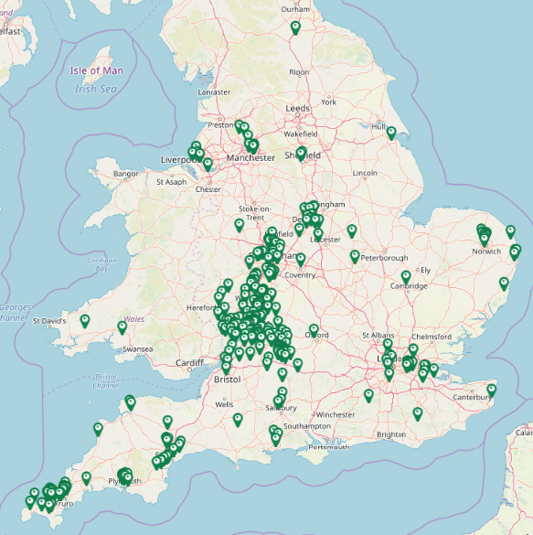
Six Years of the GDPR: Six Things You Need to Know
Richard Morley
rmorley@schoolpro.uk
DPO@schoolpro.uk
www.schoolpro.uk
@SchoolProTLC

