Slide 1
Cost effective routes to decarbonisation for schools – case study
Prash Kidiyoor
01/05/2024

Slide 2
agenda
The challenge
The approach
The solution
The benefits

Slide 3
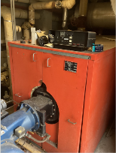
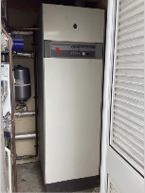
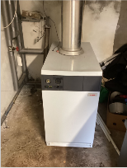
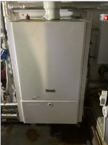
The challenge
Ageing assets and mixed aged buildings
Rising utility costs
Complex utilities delivery structure
Lack of visibility, control and data
Funding/Capital
Climate resilience
Providing a world class education service

Slide 4
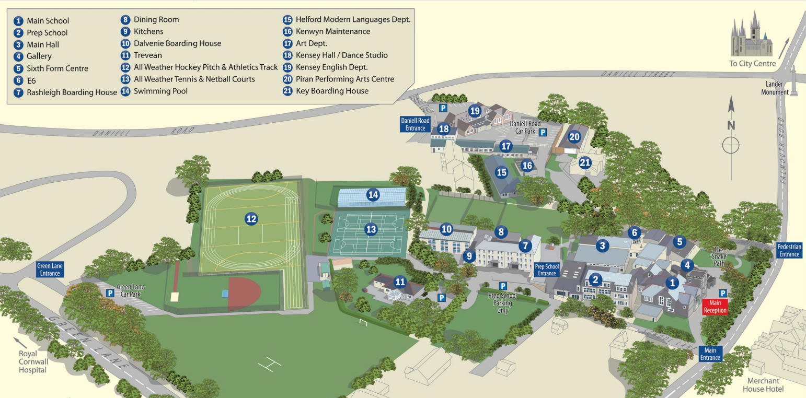
The Approach

Slide 5
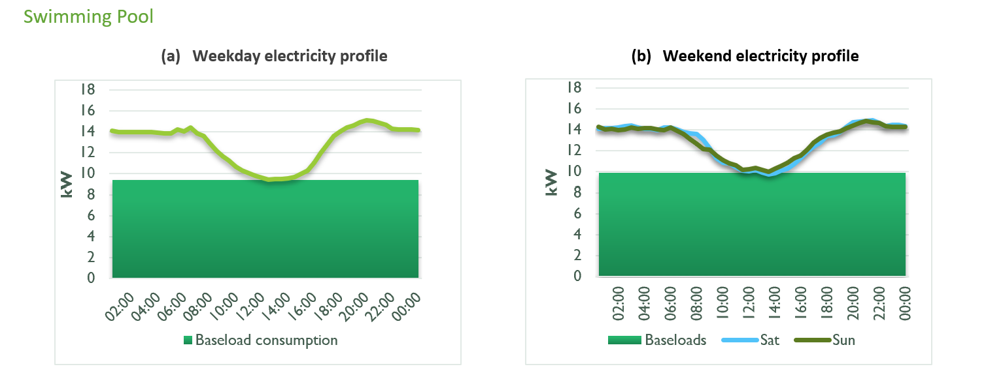
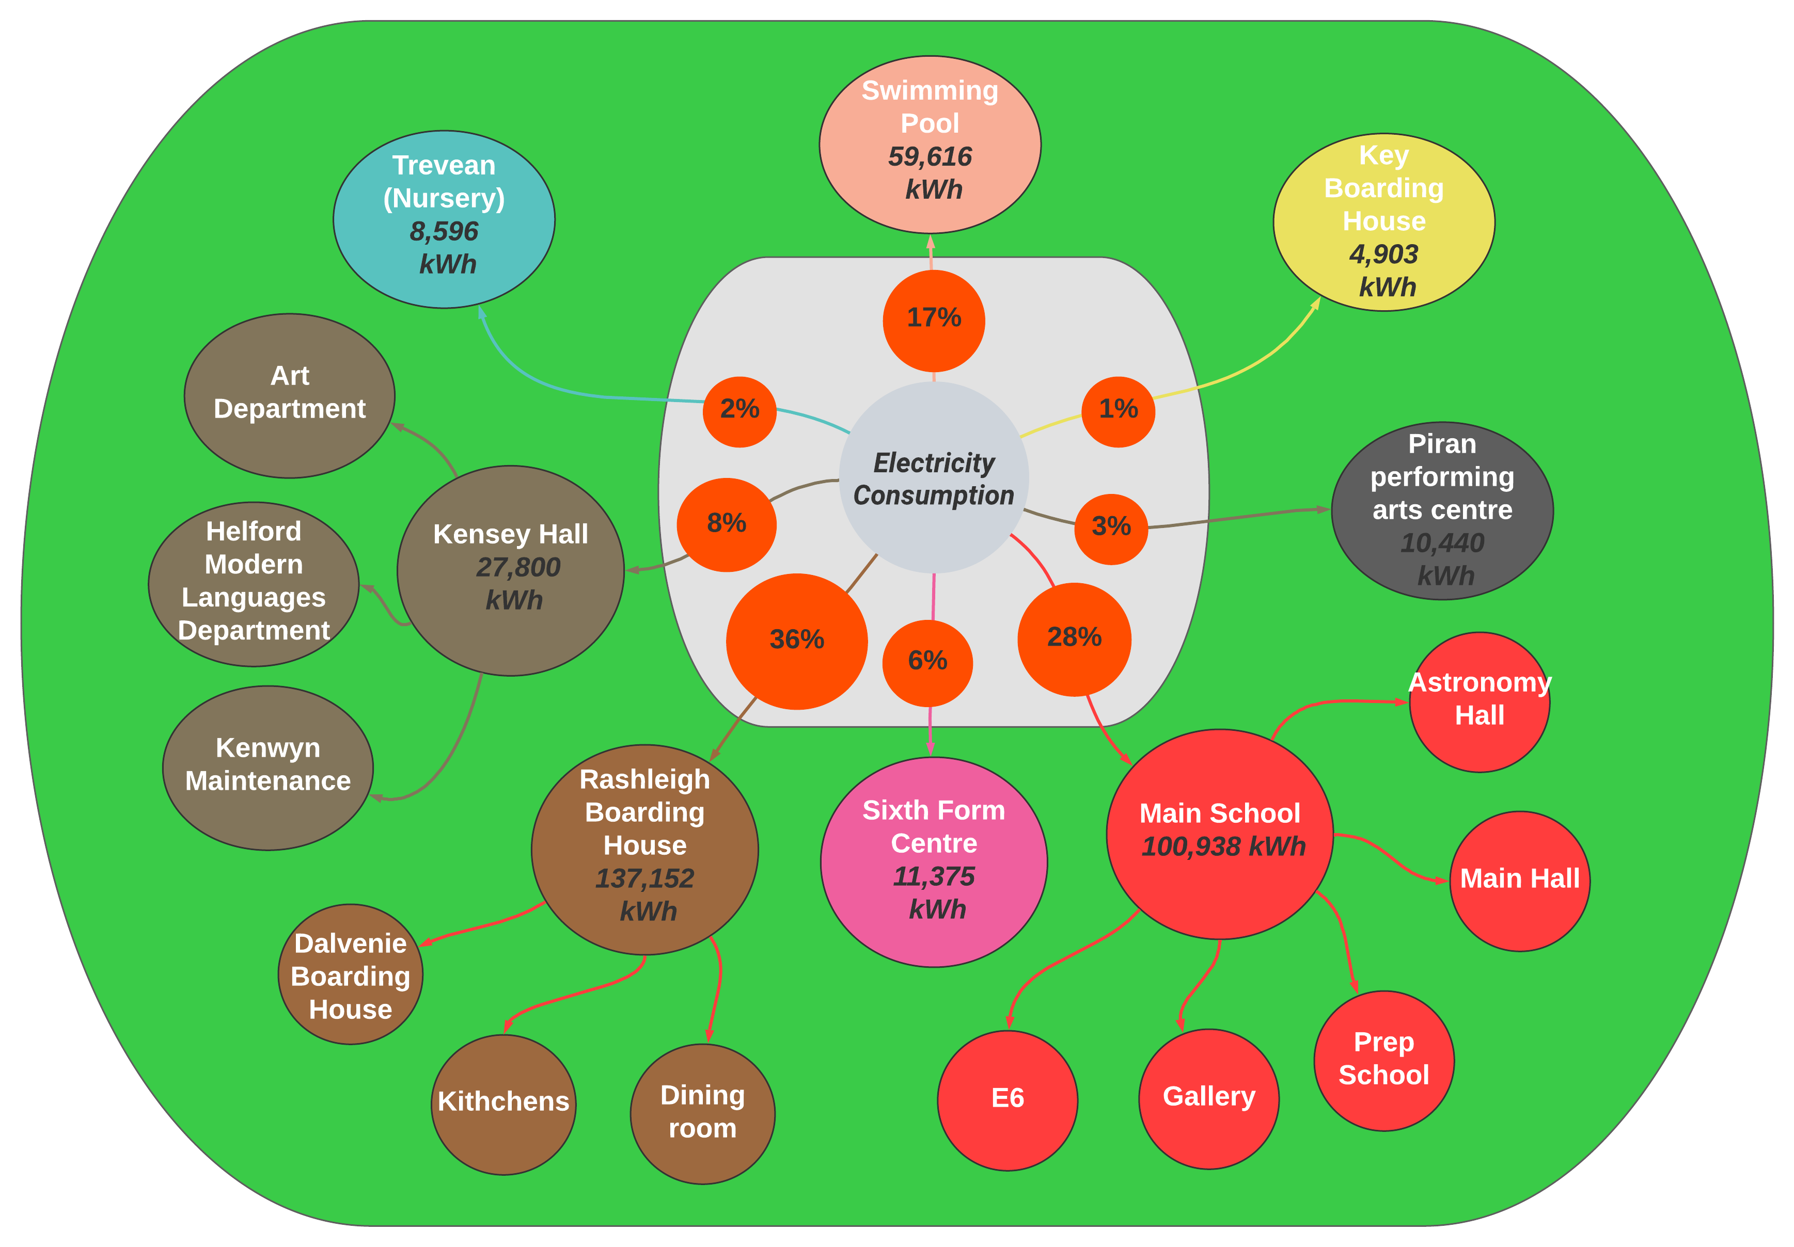
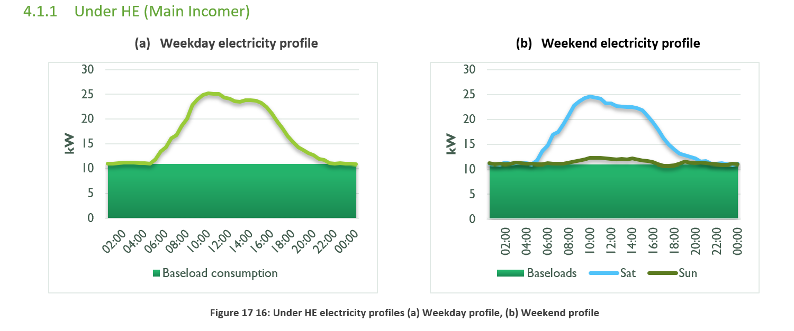
The Approach

Slide 6
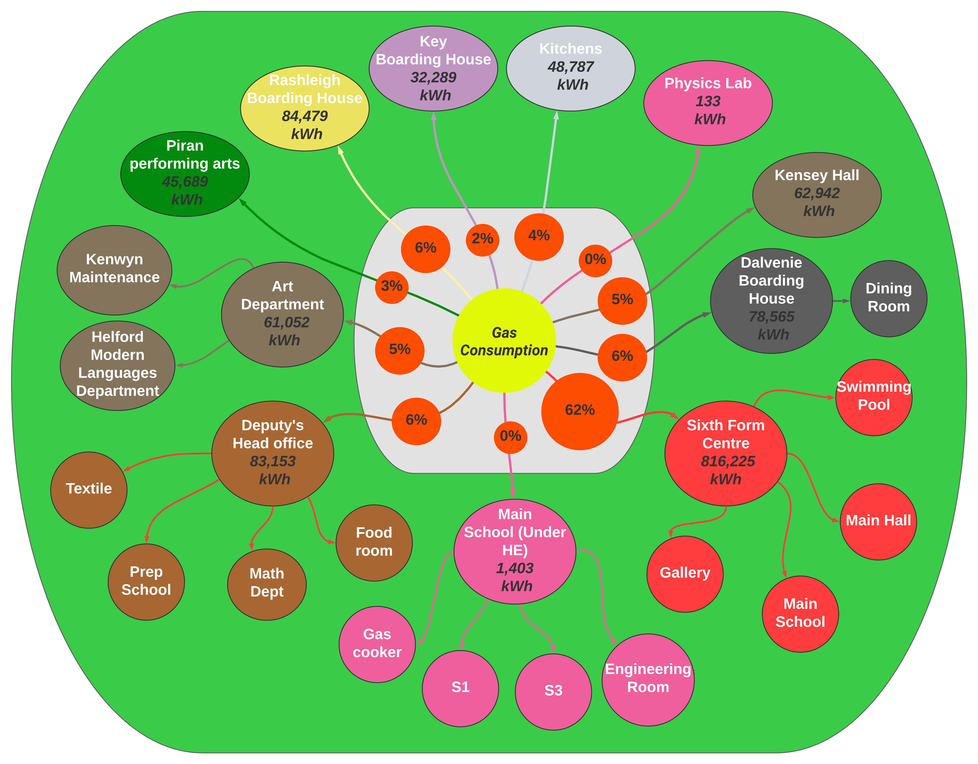
The Approach
Key buildings:
6th form centre | 62%
Rashleigh | 6%
Dalvenie | 6%
Deputy’s HO | 6%
Arts & Kensey | 10%
Total | 90%

Slide 7
The solution

Slide 8
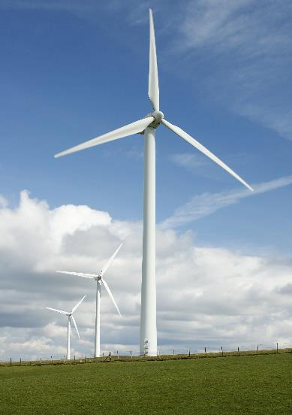
The solution: 30+ measures
The carbon waterfall follows the net zero hierarchy
ENERGY EFFICIENCY
HEAT DECARBONISATION
GREEN POWER
CARBON COMPENSATION
SCOPE 1
Smart, local controls
Insulation (pipework & fabric)
6th form modular boilers & heat pumps
ASHPs
SCOPE 2
Roof top solar PV

Slide 9
The solution: 30+ measures
Category | Contribution (tCO₂e) | % contribution | Cost savings | Capital Costs | Payback period
Current carbon emissions | 310.46 | 100%
Energy efficiency | 60.4 | 19% | £10,890 | £65,377 | 6.0
Heat Decarbonisation | 190.6 | 61% | -£96,652 | £2,505,580 | N/A
Energy generation | 30.3 | 10% | £61,994 | £302,800 | 4.9
Carbon offsetting | 26.28 | 8% | - | - | -

Slide 10
Pathways to net zero

Slide 11
The benefits
~£11k immediate energy cost savings
~60k savings from renewable generation
Bitesize priorities
Phased programme
Improved control
Immediate works
Future proof
Resilient
Business cases
Clear implementation plan
Better environment
Decarbonised estate

